Slide 1
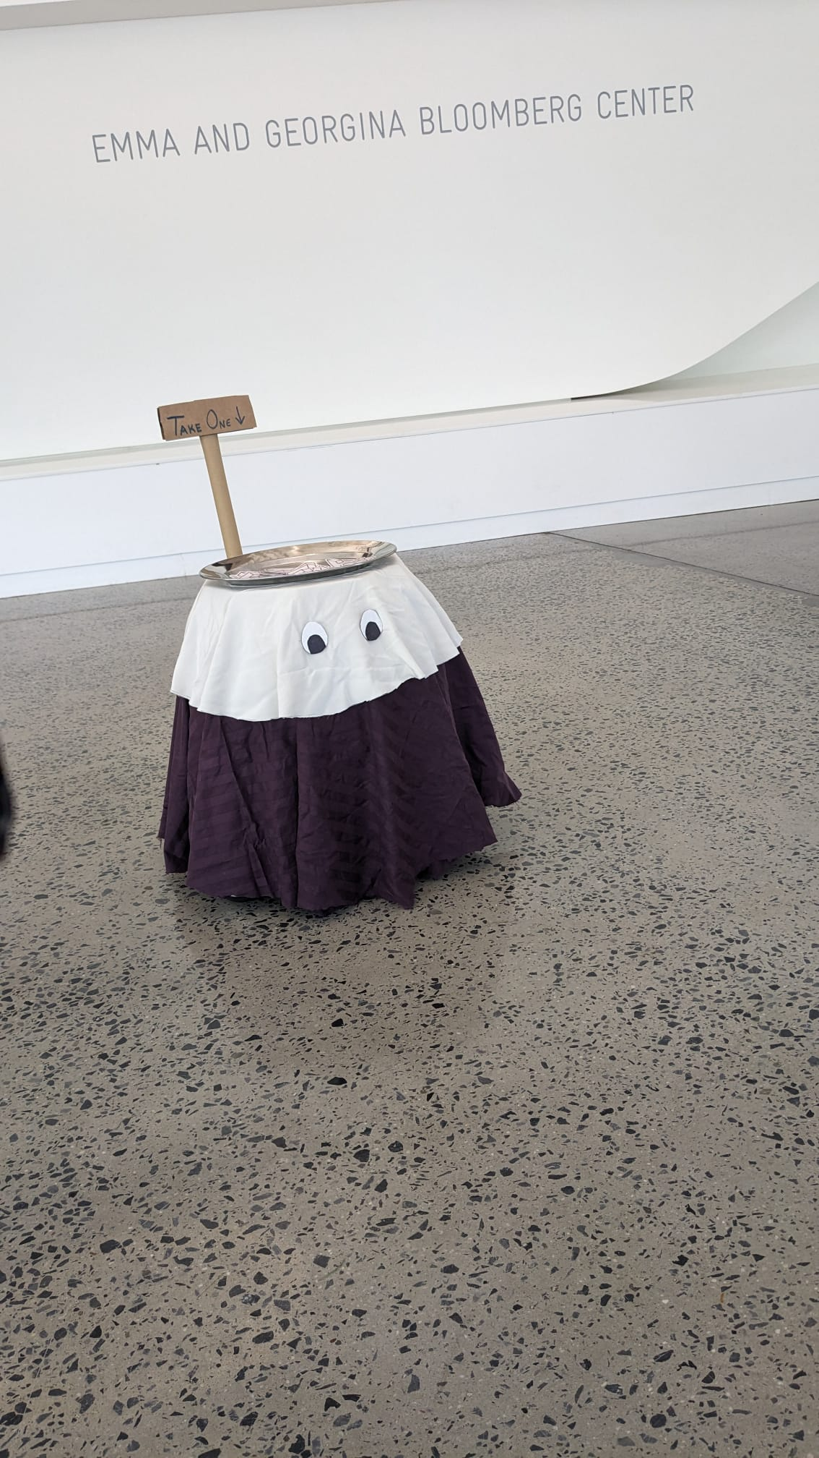
“TAKE ONE!”: does anthropomorphism make robots more approachable?
May 2023
Trevor Morcott (trm75)
Maria Teresa Parreira (mb2554)
Pratul Tandon (pt347)

Slide 2
01
Introduction
02
Robot Design
03
Robot Demo
04
Data Collection
05
Results
06
Discussion for future work

Slide 3
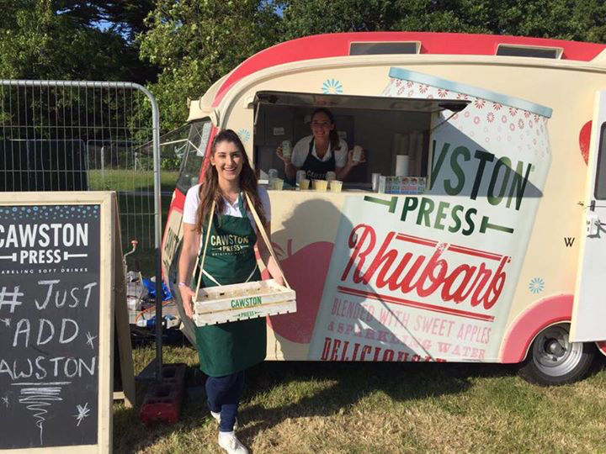
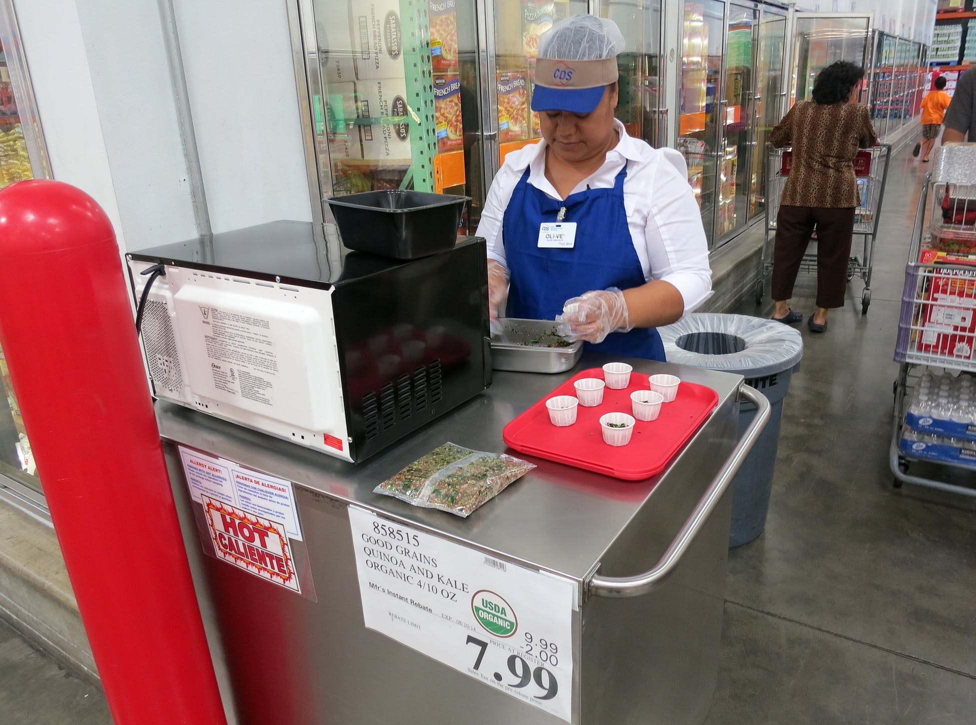
Motivation

Slide 4
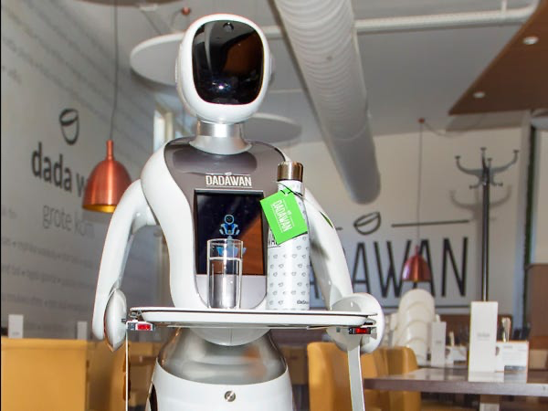
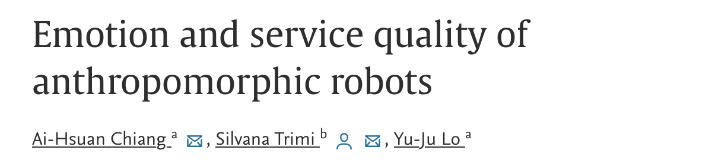
Motivation
Related work in hospitality context
Sample Bot - applicable to diverse settings, not just food service

Slide 5
Robot Design - Design Principles
Physical Design
Easily iterated, accessed and repaired No part of the robot should be difficult to replace; electronic sub-assemblies should be easily accessible
Clean, purposeful design Robot look and design should not distract the user from the intended purpose and purpose should be very intuitive from the look
Stable and robust The robot should be well balanced while moving and robust to bumps, falls and rough surfaces
Software Design
Consistent Control of the robot should be easily replicable and consistent

Slide 6
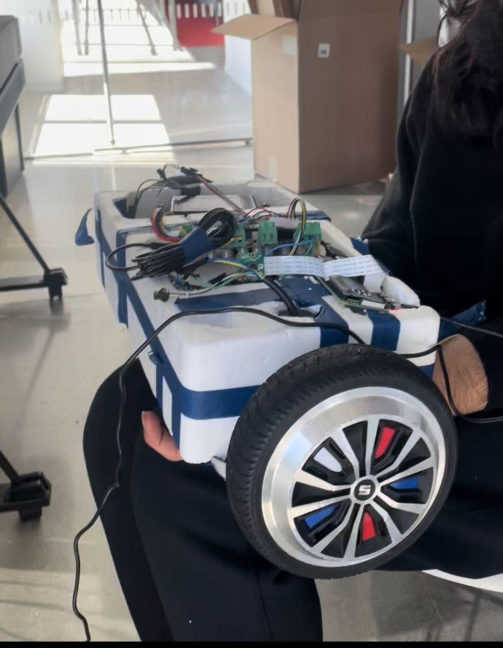
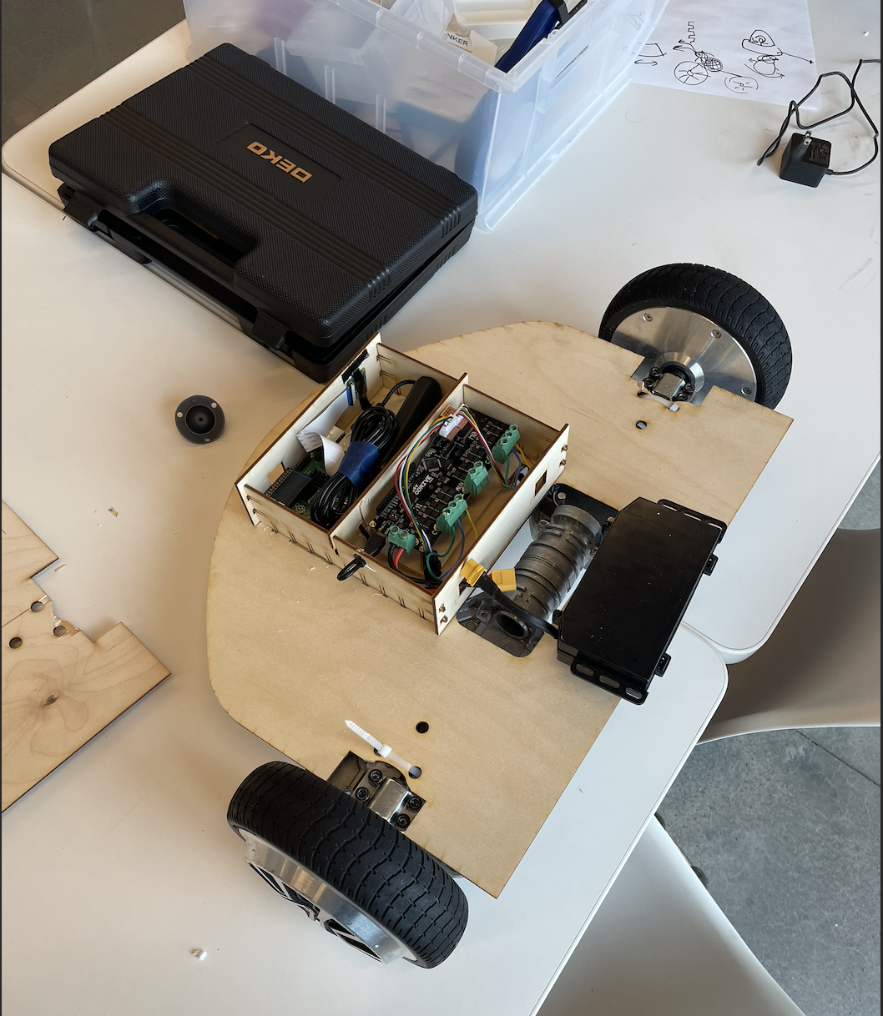
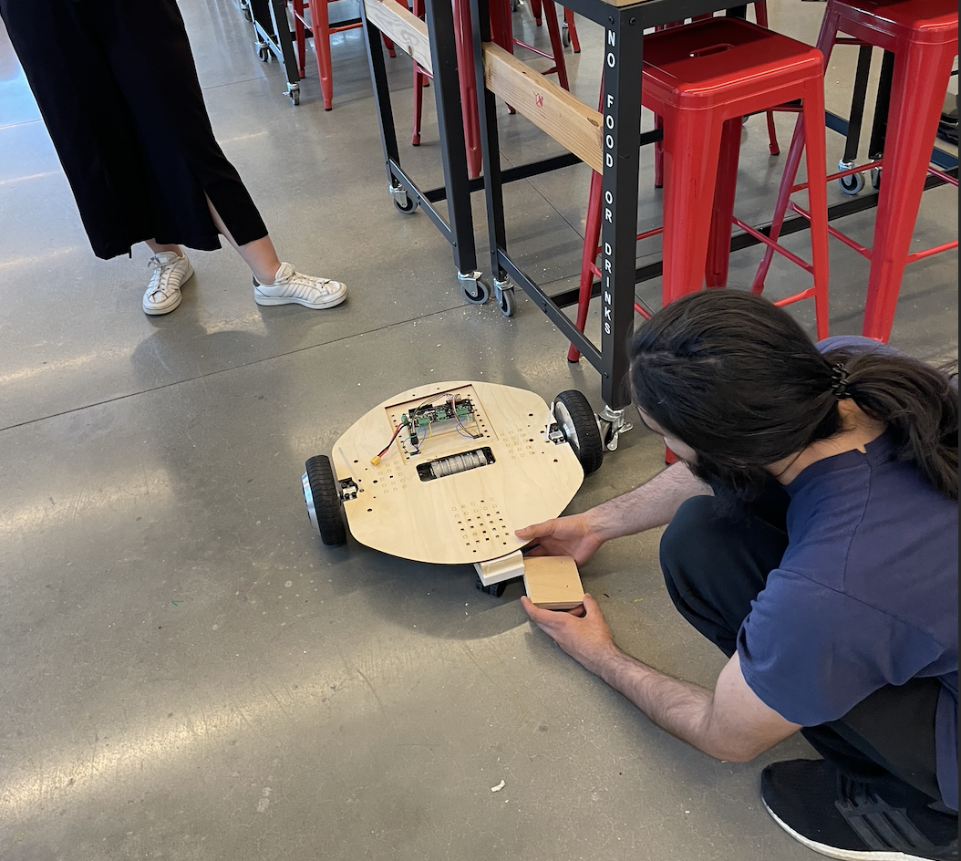
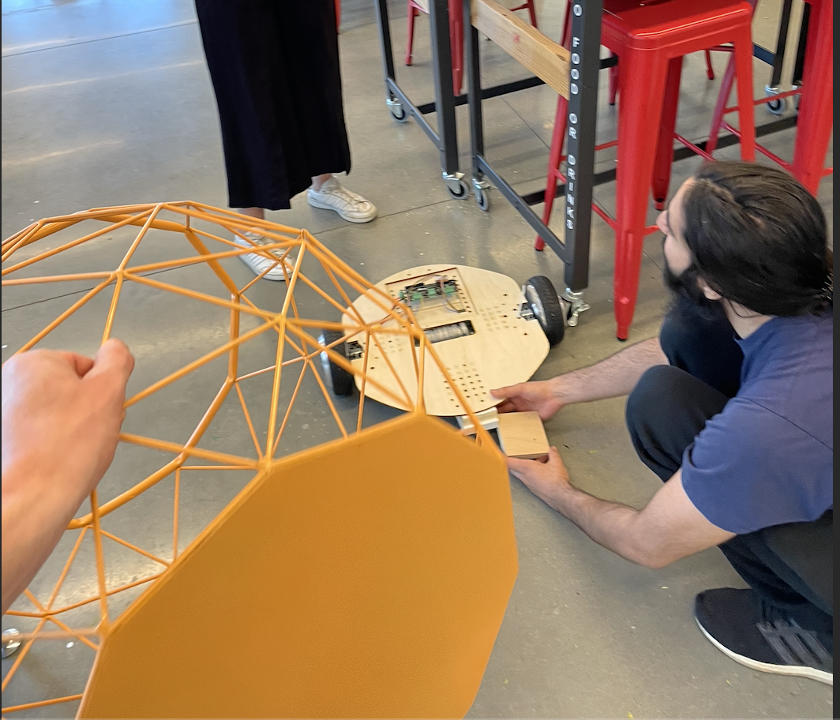
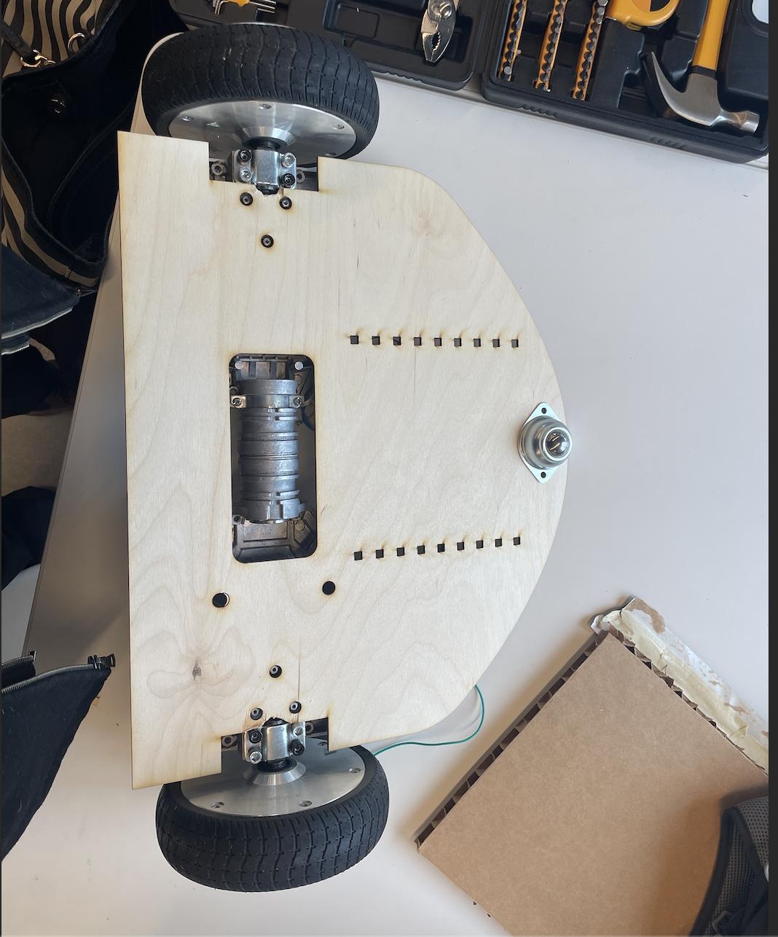
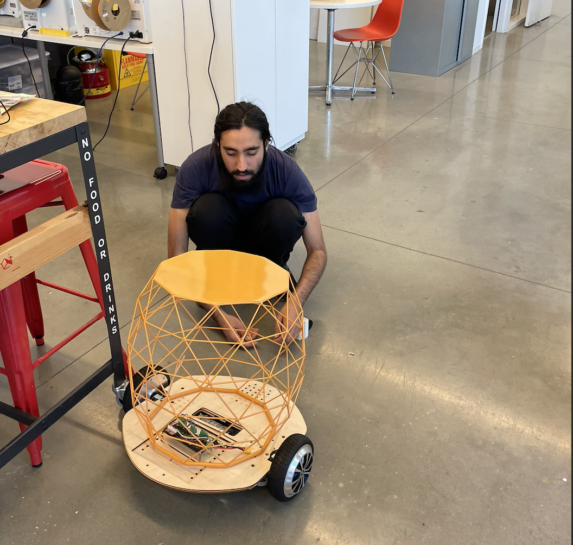
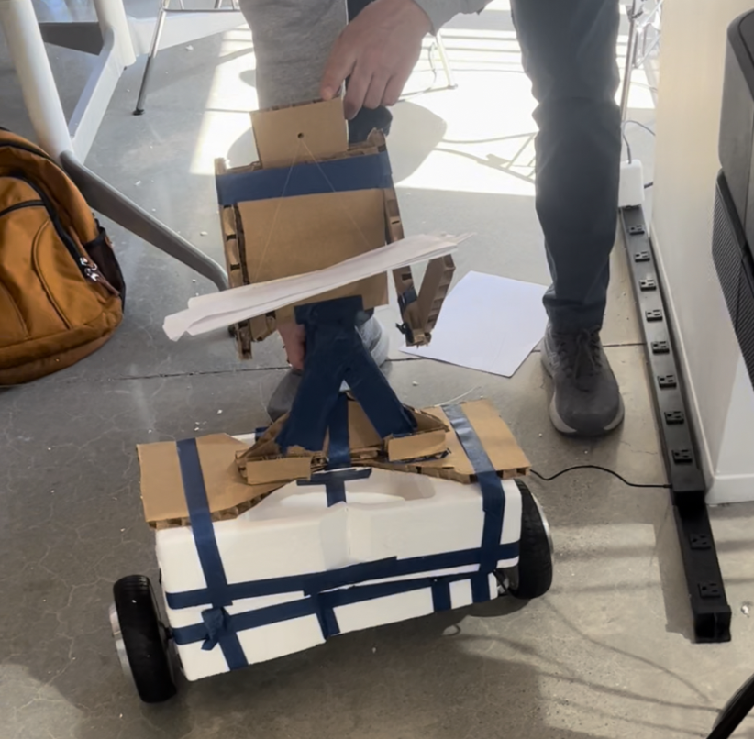
Robot Design - Prototyping
Styrofoam MVP
Initial cut chassis
Improved Stability
Table Added

Slide 7
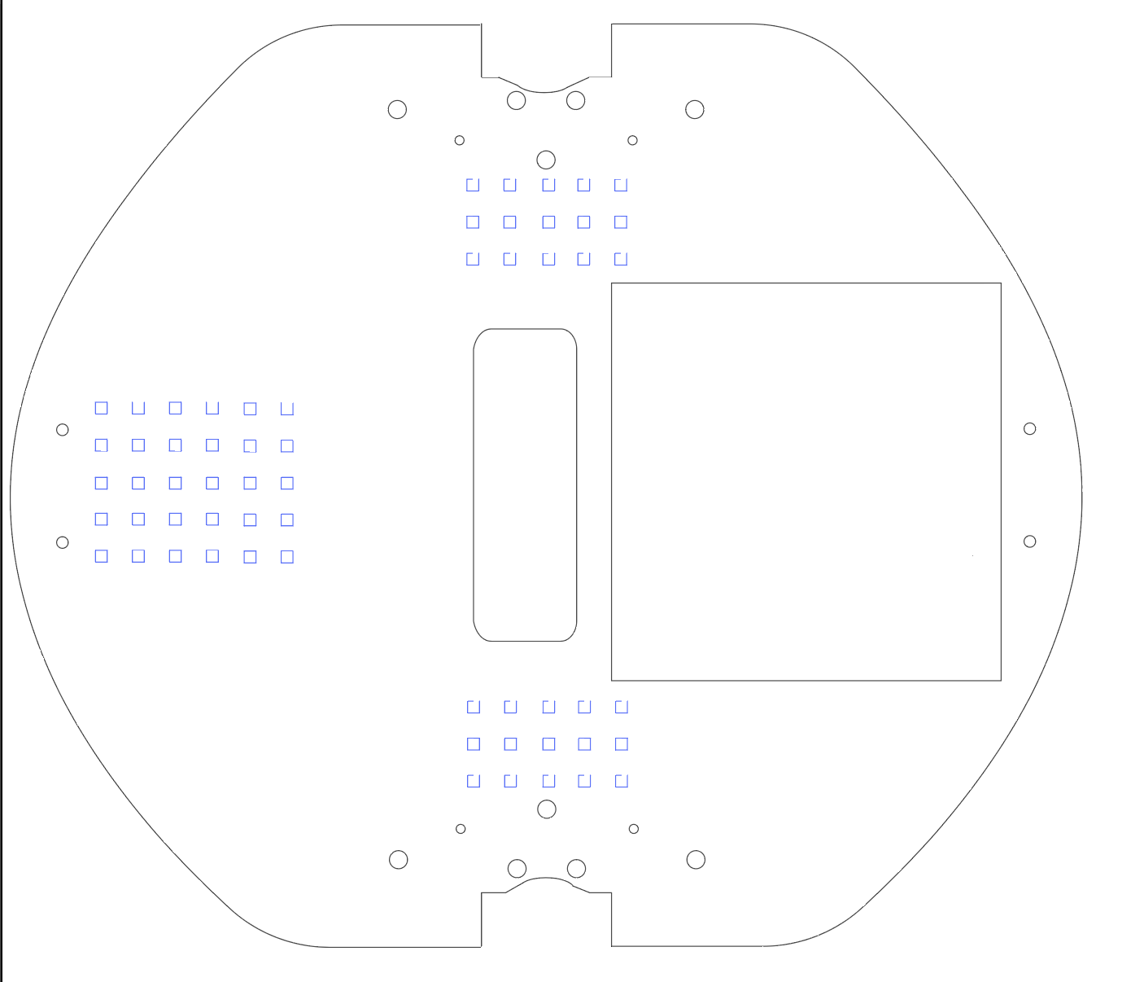
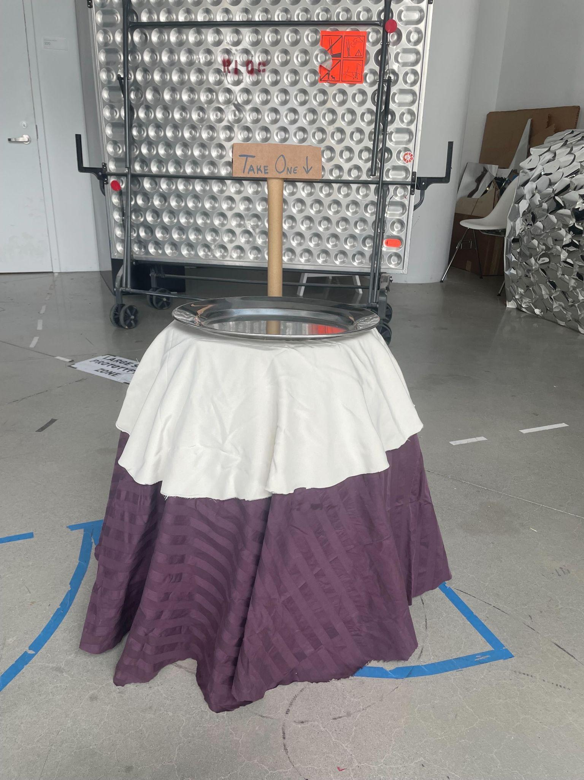
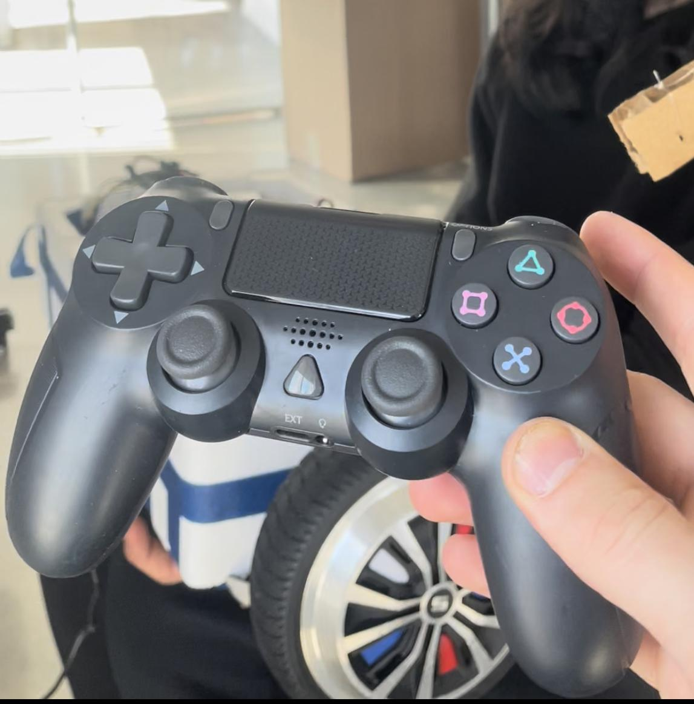
Robot Design - Final output
Laser Cut Base (V8)
Eyes
Control - Remote Piloted
No eyes

Slide 8
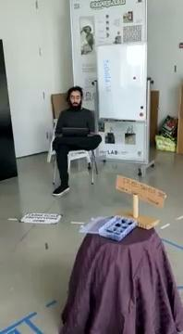
Robot Demo
Notes:
Linear, predetermined experiment process

Slide 9
Data Collection
Setting: Tata lobby; Bloomberg lobby
Participants: in-the-wild data collection, likely Cornell Tech community
Material: 2 Go Pros; 1 notebook
Time: 45 min pilot; 30 min NO-EYES; 30 min EYES;
- Context: Robot distributes free stickers.
Notes:
TERESA

Slide 10
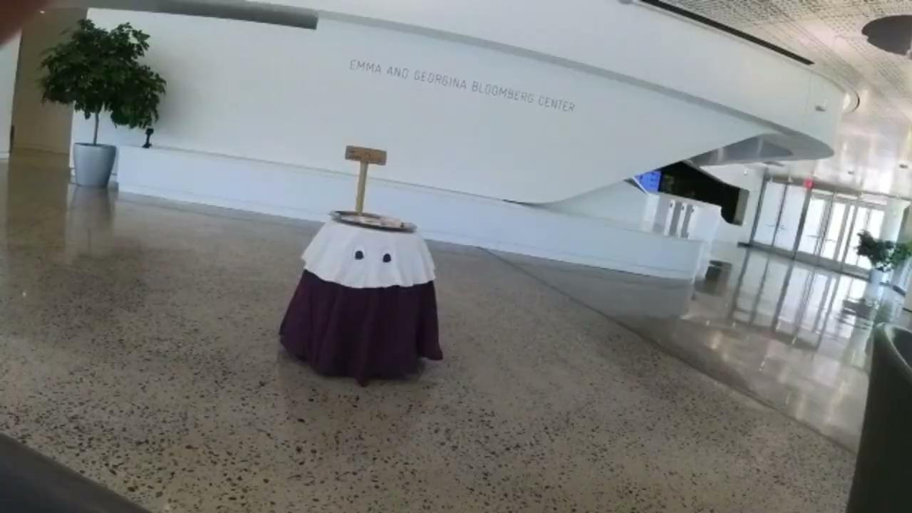
Results
Notes:
Linear, predetermined experiment process

Slide 11
Results
NO EYES
36 interactions
16 did not take one sticker (44%)
10 got approached and took one (28%)
14 approached robot and took one (38%)
EYES
25 interactions
16 did not take one sticker (64%)
6 got approached and took one (24%)
3 approached robot and took one (12%)
Notes:
TERESA

Slide 12
Discussion
Observations:
Mind the population: is the Cornell Tech community desensitized to the tech-based unorthodox?
Perhaps also idiosyncratic: a lot of participants would look for whom could be controlling the robot
The wiggle motion made the robot more approachable: could this be because people feel “seen”?
Context matters: passersby with hands full would not approach the robot.
Why do people engage more with the NOEYES condition?

Slide 13
Thank You!

